Slide 1
Introduction to Multi-Core CPU and GPU Computation 多核心CPU和GPU計算
Class 1 Prof. Matthew Smith, msmith@mail.ncku.edu.tw

Slide 2
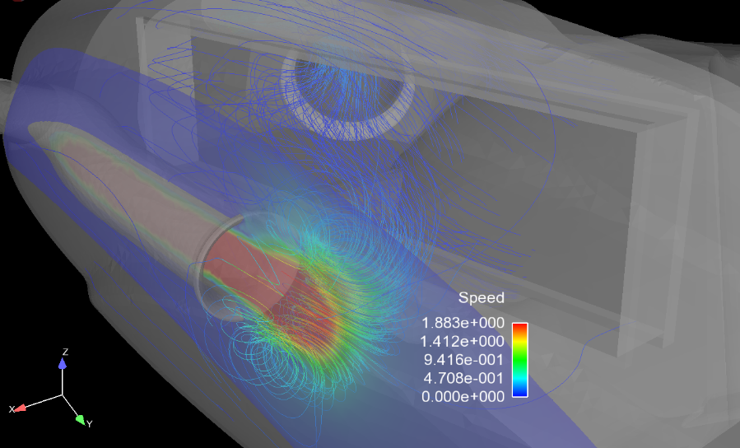
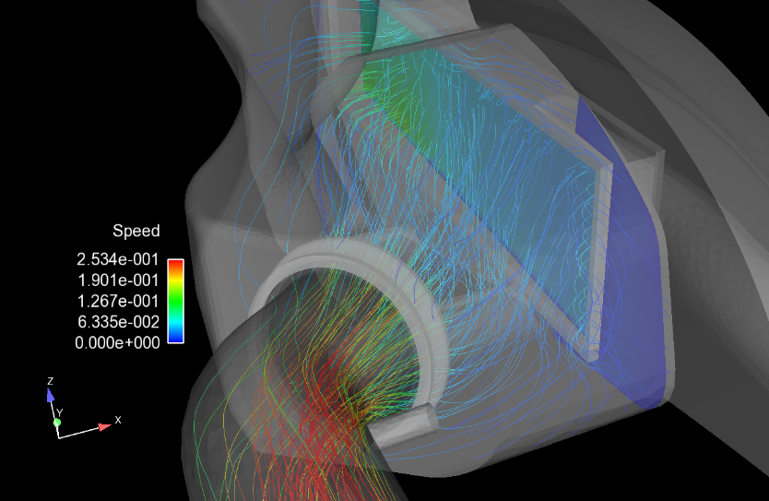
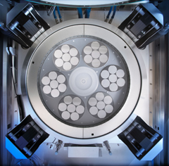
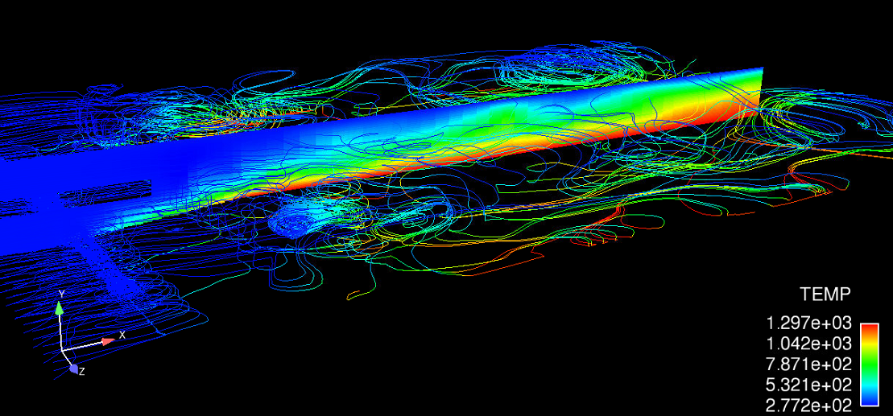
INTRODUCTION
Name: Prof. Matthew Smith (李汶樺 教授)
Born: Brisbane, Australia.
Office: 714 (Ext: 62114)
Email: msmith@mail.ncku.edu.tw
PhD: University of Queensland, Australia.
Editor – Computers and Fluids.
International organizing committee member for Parallel CFD.

Slide 3
INTRODUCTION
Background
Teaching
Courses in Solid Mechanics, Vibration, Fluid Mechanics, Engineering Analysis, Parallel Computing, Rarefied Gas Dynamics, Kinetic Theory, Engineering Graphics and Computer Programming at multiple universities all over the world.
Courses in English and Chinese.
Research
Numerous awards for research into HPC (High Performance Computing) and CFD (Computational Fluid Dynamics)
~ 50 research papers and articles published internationally.

Slide 4
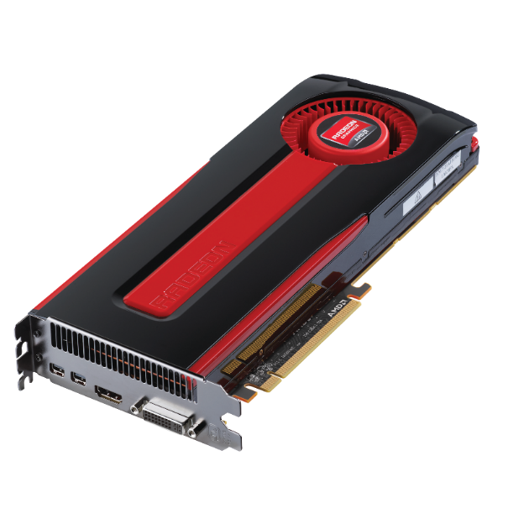
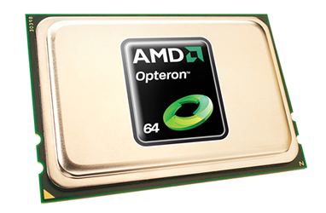
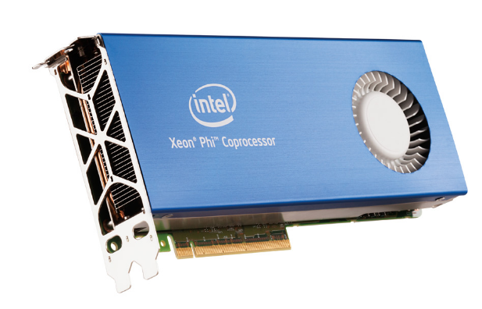
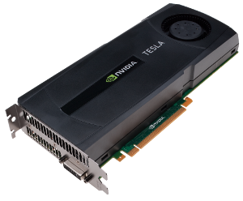
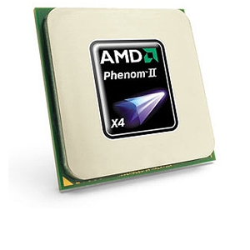
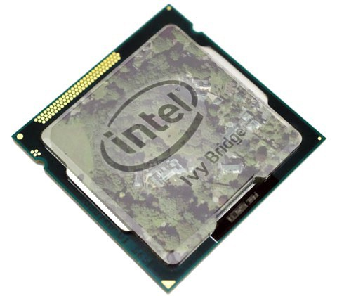
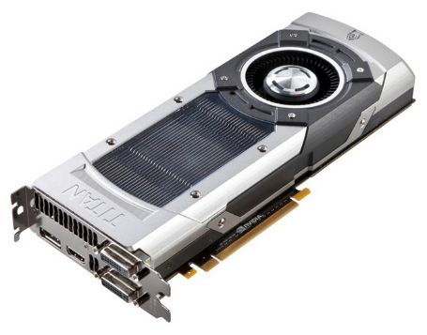
Let’s take a look at why we are here…
Multi-Core CPU
Multi-Core GPU
Multi-Core CPU Accelerators

Slide 5
Let’s take a look at why we are here…
All of these technologies are very new → Created in the last 5 years….

Slide 6
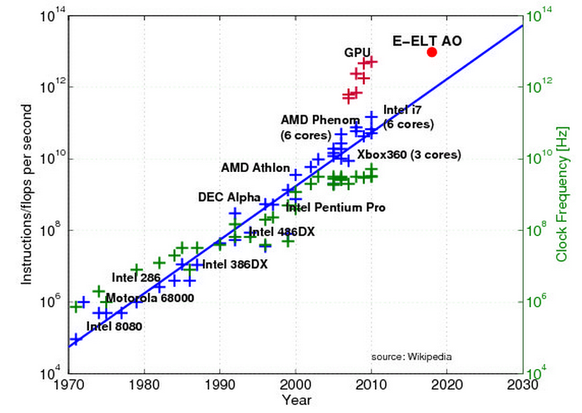
Let’s take a look at why we are here…
The computing power is growing rapidly in a short period of time.

Slide 7
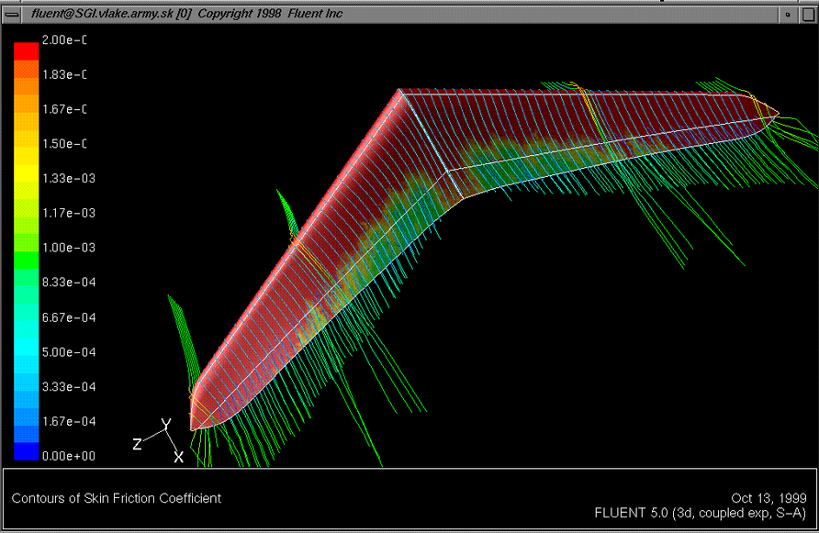
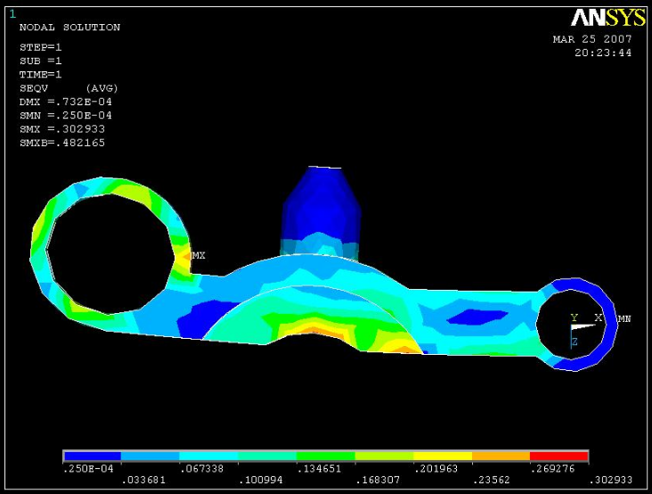
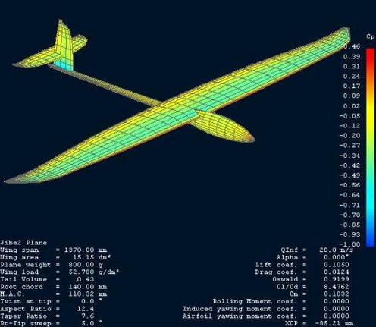
Let’s take a look at why we are here…
FLUENT: Created decades ago.
ANSYS: Formed in 1970, purchased FLUENT in 2006.
XFOIL: Formed in 2003.
Almost every piece of commercial software for use by Mechanical Engineers was developed before this novel hardware was invented.

Slide 8
Let’s take a look at why we are here…
All of this software is commonly used by Mechanical Engineers – unfortunately, despite the best efforts of the companies, the software development cannot keep up with the hardware development.

Slide 9
Why are you here?
There is a growing gap between modern computing hardware and engineering software and solvers employed in engineering analysis.
For industrial (bachelor level) mechanical engineers
There is not much we can do. We can train students in the use of modern CFD software (Ansys, COMSOL) before we graduate them.
For research (masters, PhD level) mechanical engineers (i.e. you)
We can train you to reduce this gap in order to find better solutions to real engineering problems.

Slide 10
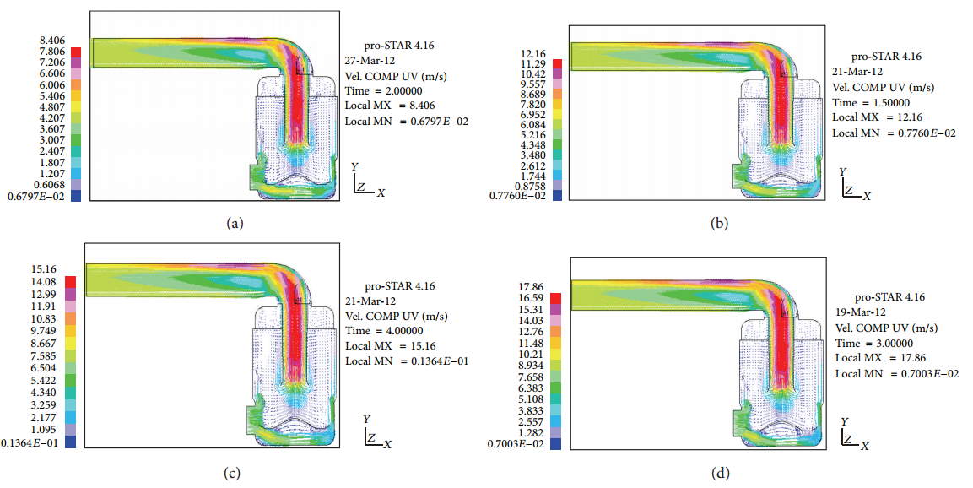
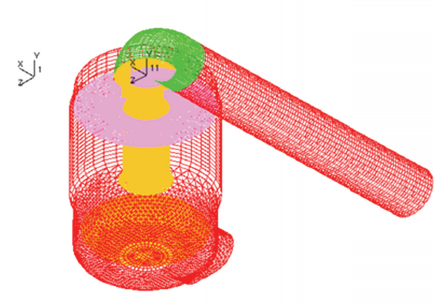
Example
Recently there is an increase in the number of automotive companies performing analysis on air-filters and intakes.

Slide 11
Example
In a research paper published in 2013, researchers employed commercial software to simulate airflow using 0.5 million cells.

Slide 12
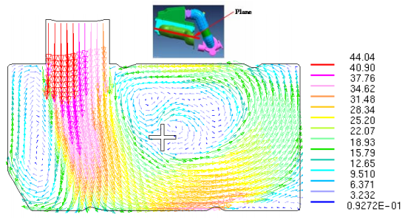
Example
This resolution is sufficient to get an engineering estimate of the flow field.
However, additional computational cells or an improved algorithm is required.

Slide 13
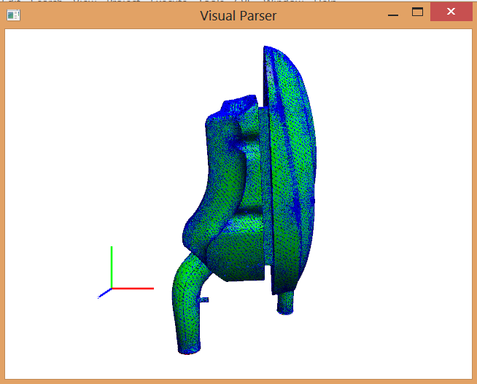
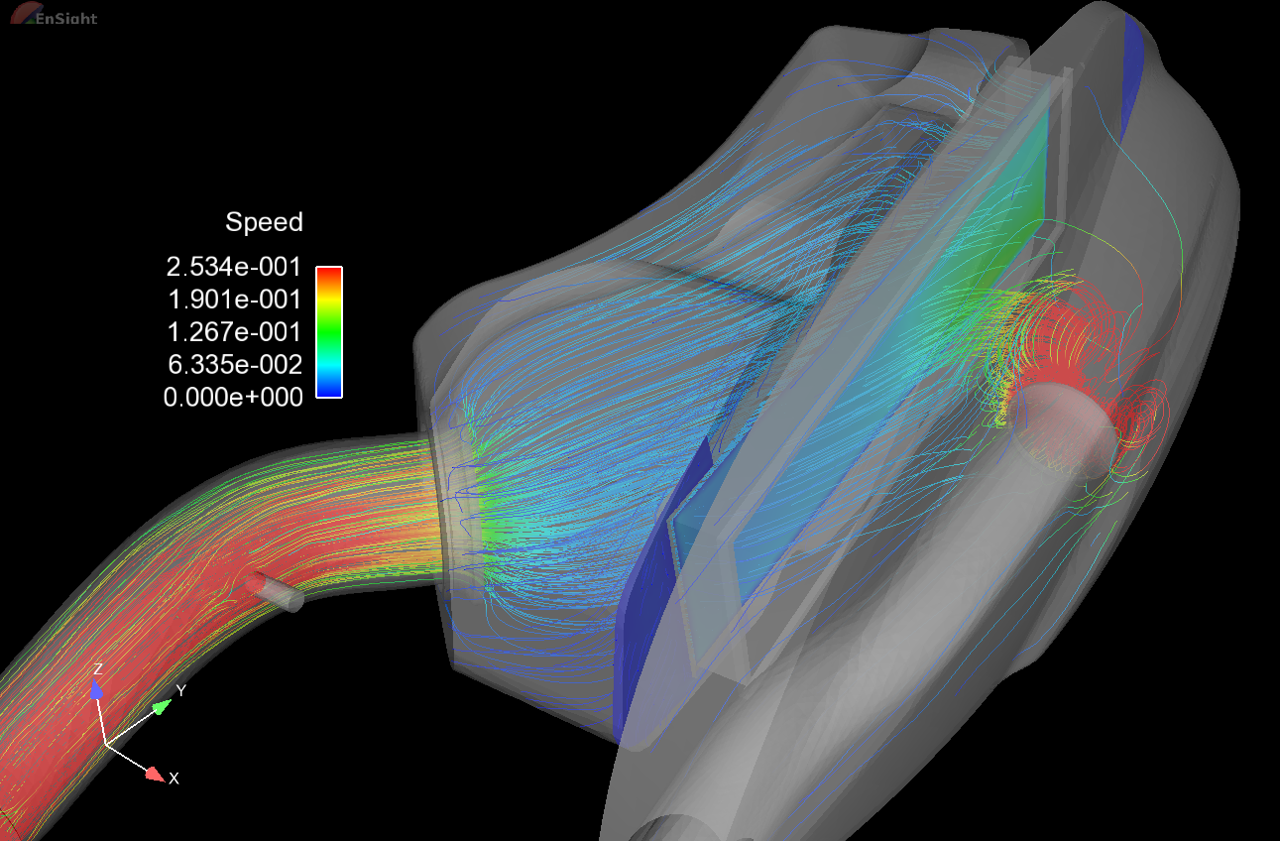
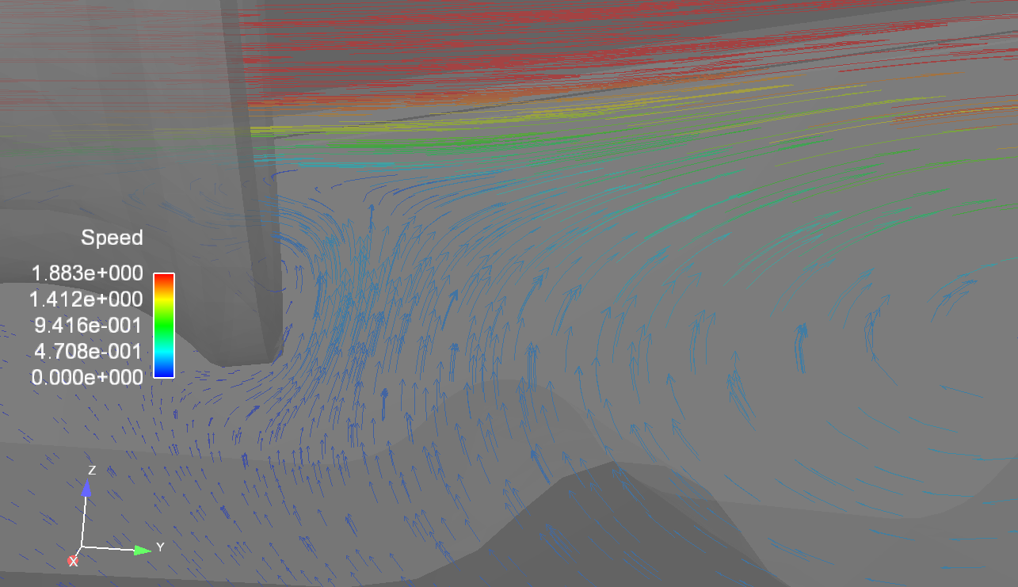
Example
A GPU version of an unstructured CFD solver is currently being developed with Kymco in order to reach much higher resolutions.
Currently running 6 months of simulation in 6 hours with a GTX-Titan.
Transient flow simulations of Kymco filter assembly using 1.51 million cells.

Slide 14


HOW DID THIS HAPPEN?
If the hardware wasn’t changed due to need from the engineering community, then why?
Modern computing technology is driven by consumers (gamers!!)

Slide 15
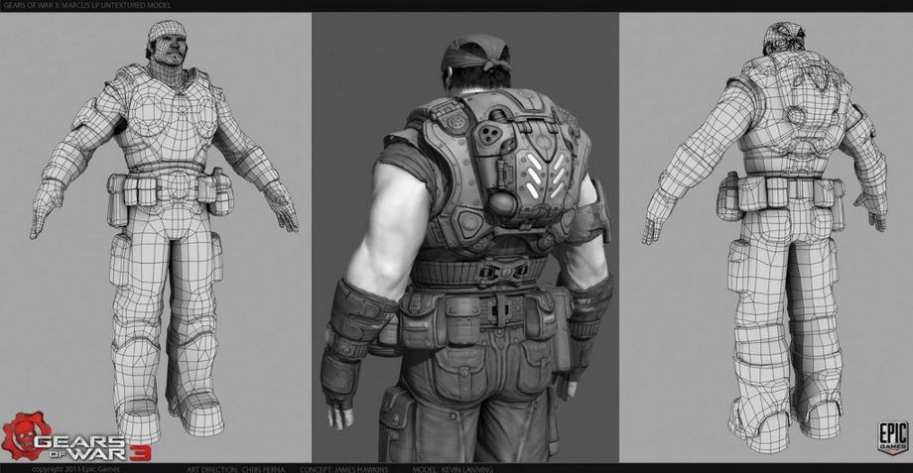
..and it isn’t easy…
Most modern games employ 3D graphics.
This requires high levels of mathematics and computational power.

Slide 16
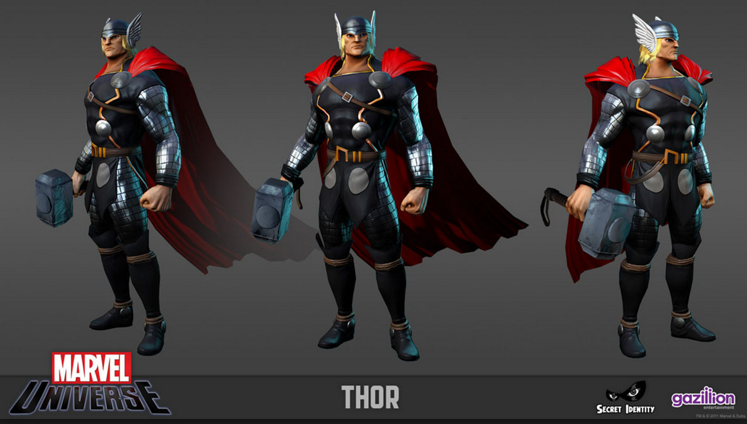
..in fact, it’s really hard!
The interaction of light with each surface is calculated.
Cel Shading requires edge computation.
Even the best computers can’t do this quickly.
→ This is one of the driving forces for gaming and graphics related hardware.

Slide 17
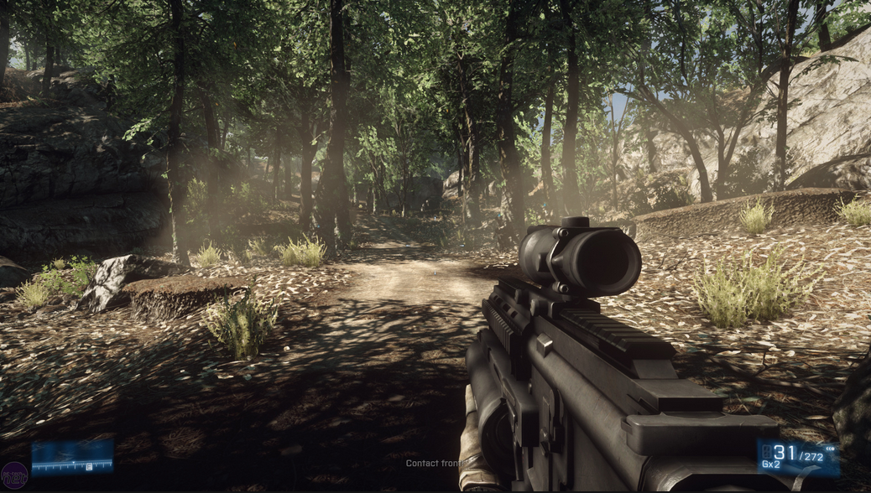
..but people pay a lot for it…
Fast Computation = Higher FPS
= $$$
This money is what funds the development of modern GPU and CPU devices.

Slide 18
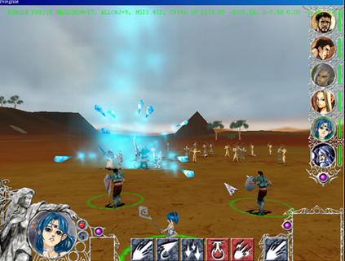
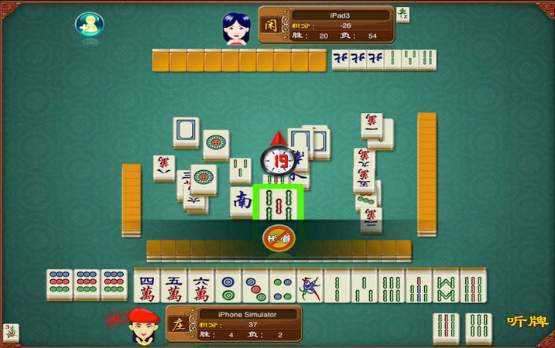
um….

Slide 19
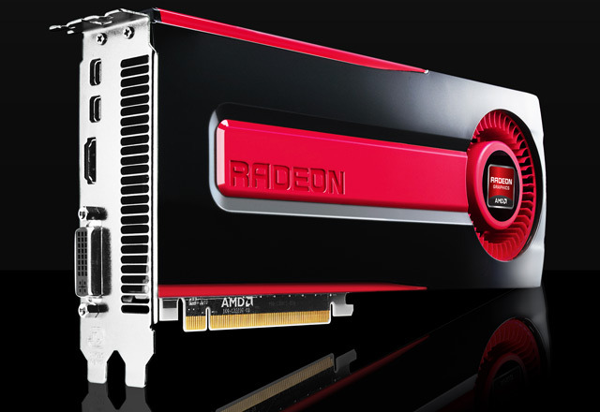
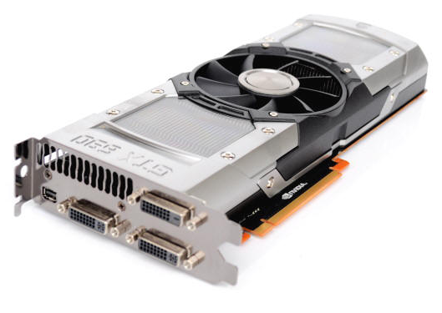
Modern CPU and GPU devices
Anyone care to guess how many stream processors are in this devices?
AMD HD7970
ANS: 2048 Processors
GTX-Titan
ANS: 2880 Processors
GTX-690
ANS: 3072 Processors

Slide 20
Why are you here?
During this course, you will learn the skills you need to:
Develop your own parallel codes on every modern parallel computing hardware available → CPU, GPU and Phi.
Write your own parallel codes for Finite Volume, Finite Difference and Finite Element methods.
Accelerate your own research → Get better results (or get bad results sooner) by taking advantage of this new technology.

Slide 21
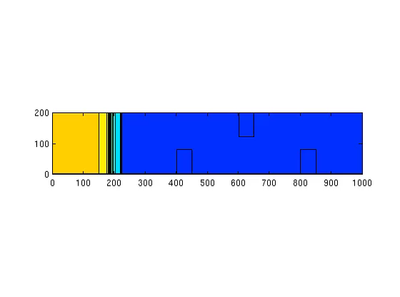
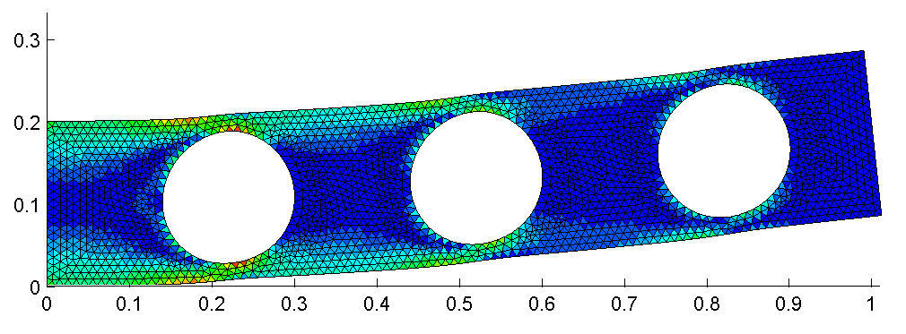
IN RECENT YEARS…
You may have seen some of the things we worked on in previous years…

Slide 22
2015 Course OUTLINE
There are 4 key parts to this course:
C/C++ Coding using Linux.
OpenMP (CPU) parallelization.
AVX parallelization
GPU parallelization
You will learn about Finite Volume, Finite Element and Finite Difference – but I’ll give you the codes and all reference material for these.
By the end, you’ll be solving engineering problems.

Slide 23
Assessment CRITERIA
The course will be assessed by:
Mid-Semester exam (3 hours, 30%)
End-of-Semester exam (3 hours, 30%)
Major Project (40%)
Group Oral Presentation: 10%
Group Report: 30%

Slide 24
Assessment CRITERIA
The Mid-Semester and End-of-Semester exams will be open book, paper exams.
They will be held in the computer classroom. You can go online, bring all material with you etc. during exam.
You will be asked to write computer programs and solve theory questions (related to the course material) during the exam.
Item | Date | Details
Mid-Semester Exam (30%) | Week 8 (During Wednesday tutorial) | Contain questions regarding parallel computing, C/C++ programming, OpenMP and AVX/SSE.
End-of-Semester Exam (30%) | Week 17 (During Wednesday tutorial) | Contain questions regarding GPU computing, CUDA programming, FDM, FVM, and FEM.
Major Assignment (40%) | Week 18 | To be discussed.

Slide 25
Assessment CRITERIA
The major assignment is a project which is completed in groups of 3 students.
The project will be issued on Wednesday this week.
The project will require a major amount of work by each group.
Item | Date | Details
Mid-Semester Exam (30%) | Week 8 (During Wednesday tutorial) | Contain questions regarding parallel computing, C/C++ programming, OpenMP and AVX/SSE.
End-of-Semester Exam (30%) | Week 17 (During Wednesday tutorial) | Contain questions regarding GPU computing, CUDA programming, FDM, FVM, and FEM.
Major Assignment (40%) | Week 18 | To be discussed.

Slide 26
Assessment CRITERIA
The assessment breakdown of the major project is as shown below:
Oral Presentation: 10 minute presentation given at the end of semester. (10%)
Final Project report: 15-20 page formal engineering document describing the solution to the problem assigned. (20%)
Progress Reports: Discussion and interviews with the project teams and review of the project log books. (10%)
Item | Date | Details
Mid-Semester Exam (30%) | Week 8 (During Wednesday tutorial) | Contain questions regarding parallel computing, C/C++ programming, OpenMP and AVX/SSE.
End-of-Semester Exam (30%) | Week 17 (During Wednesday tutorial) | Contain questions regarding GPU computing, CUDA programming, FDM, FVM, and FEM.
Major Assignment (40%) | Week 18 | To be discussed.

Slide 27
Course Overview
Timetable → All classes within the computer laboratory.
Lectures:
2pm-3pm (6), Monday (In Lab)
1pm-2pm (5), Wednesday (In lab)
Tutorials/Prac:
2pm-4pm (6-7), Wednesday (In lab)
(Straight after the lecture)
Due to budget restrictions, this class will not accept sit-in students.
All students must be enrolled in the subject, unless prior arrangements have been made.

Slide 28
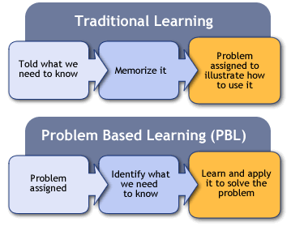
Problem Based Learning
Problem Based Learning (PBL) is an education paradigm used during this course.
Key points will be:
Students receive the problem before learning how to solve it.
They identify what they need to learn to solve the problem.
With a little help, find the material and learn how to solve it.

Slide 29
Problem Based Learning
Students in this course learn through application of complex and realistic problems (during tutorial / practical time)
Student Centered!!
If you have any ideas about an application for parallel computing, I can accept it as alternative credit for the course.
It’s good for engineering students.
Complex + Realistic = Engineering

Slide 30
Problem Based Learning
Students (in groups) attempt to solve a problem in small groups.
The information required to solve the problem will either:
Be found by the students themselves (90% of the time), or
Provided by the “guide” (ME) (10%)
I will help with minor things like coding, syntax, English and computer related issues.

Slide 31
Problem Based Learning
Sources of information:
Google (i.e. Internet)
Library (i.e. books)*
My notes for the course,
Other Professors (yes, you can ask for their help if you need it)
Me (if you can run faster than I can)

Slide 32
Computing Facilities @ ME
During this class, we will use the computers in this room to remotely connect to a HPC work station.
We will NOT be using these computers to perform computation - all programming and execution will be performed on the workstation.
We will use these computers for post processing only.

Slide 33
Computing Facilities @ ME
High-Performance Heterogeneous Computing Laboratory Hardware
Machine A - Intel Xeon E5-2670 x 2 (16 cores total)
16 cores, 32 threads
128 GB DDR3 Ram (Max 256 GB)
GTX-TITAN GPU (6 GB Ram)
Intel Xeon Phi (MIC) card (6 GB RAM)
Software:
Centos 6.5+
Intel Compiler (ICC), CUDA version 5.5

Slide 34
Computer Server Access
GPU_1 | 李暐昱 | OK
GPU_2 | 李昌儒 | OK
GPU_3 | 賴柏毓 | OK
GPU_4 | 張元睿 | OK
GPU_5 | 練羽軒 | OK
GPU_6 | 陳立昕 | OK
GPU_7 | 黃詠郁 | OK
GPU_8 | 黃敬傑 | OK
GPU_9 | 周鼎鈞 | OK
GPU_10 | 游峻強 | OK
GPU_11 | 邵奕崴 | OK
GPU_12 | 謝坤晉 | OK
GPU_13 | 白子洋 | OK
GPU_14 | 阮黃智 | OK
GPU_15 | 楊智堯 | OK
GPU_16 | 王澔宇 | OK
GPU_17 | 吳宗翰 | OK
GPU_18 | 陳秉洋 | OK
Each student will have their own private username, as shown here.
For example, will have the username “GPU_1”.
When you log into the server, this will be the username you use.
Your password is your student number.
When you log-in, I strongly advise you to change your password. I will give you instructions on how to do that in the next class.

Slide 35
Computing Facilities @ ME
My advice:
If you have your own multi-core laptop, I thoroughly recommend you use it.
To remotely access the server with your own laptop, you need only get the program “Putty” – which is a single file and does not require installation (I can provide this).

Slide 36

Windows vs. Linux
The lab computers are Windows machines.
Two choices for development:
Linux (ISO) using G++/GCC
Windows using Visual Studio
The compulsory O/S of this course is Linux.
All work should be performed using Putty or SSH → You won’t need Visual Studio.

Slide 37
REMOTE / FTP SERVER
The server (used for classwork) for this subject is located at 140.116.71.64.
You can use this IP address to:
Download the course material, assignments and current grades.
Log into the course supercomputing workstation to perform computations using multiple Xeon cores or GPU devices.
ftp://140.116.71.64 Username: NCKU_GPU P/W: NCKU_2014$

Slide 38
REMOTE / FTP SERVER
On the FTP, you’ll find the PPT’s we use during class time – you can download these at any time.
Grades for your mid-semester, end of semester and all other activities are also there.
You can also find your major assignment.

Slide 39
Consultation Times
If you need some help regarding the course or life in general:
Monday 1pm-2pm
I’ll be the TA for this subject, so if you need any help, don’t hesitate to ask.

Slide 40
End of CLASS

